Slide 1
Analyzing and Visualizing the Canadian Research Landscape
Reference to this paper:
Victor N. Silva, Ashley Herman, Maryam Mirzaei, Elisa Du, Bowen Hu, Lianne M. Lefsrud, Joerg Sander, Eleni Stroulia, and Monica Sawchyn. 2019. Analyzing and visualizing the canadian research landscape. In Proceedings of the 29th Annual International Conference on Computer Science and Software Engineering (CASCON ’19). IBM Corp., USA, 305–310.
Link to the paper:
https://dl.acm.org/doi/pdf/10.5555/3370272.3370306

Slide 2
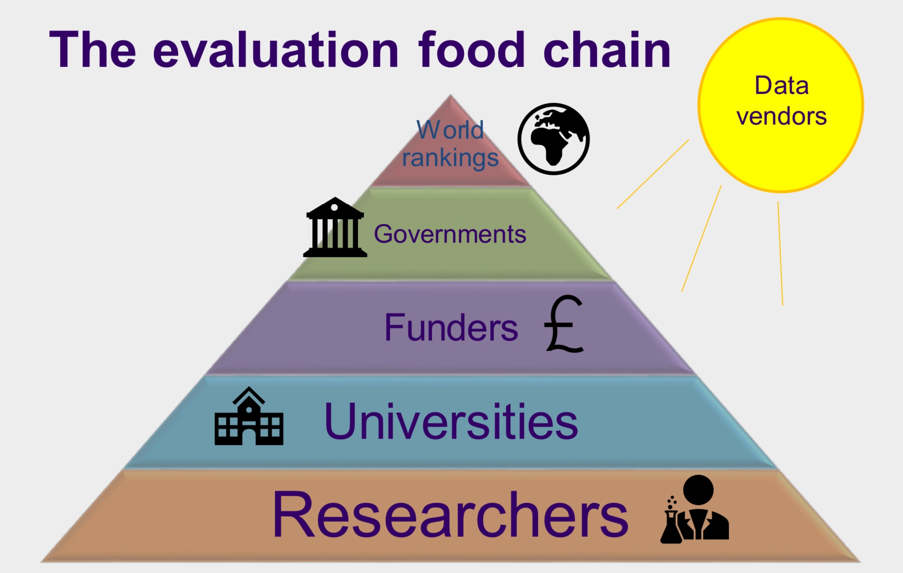
What is the problem?
Research activities:
Publications,
Proposal adjudication,
Strategic investments
Need a System to analyze work.

Slide 3
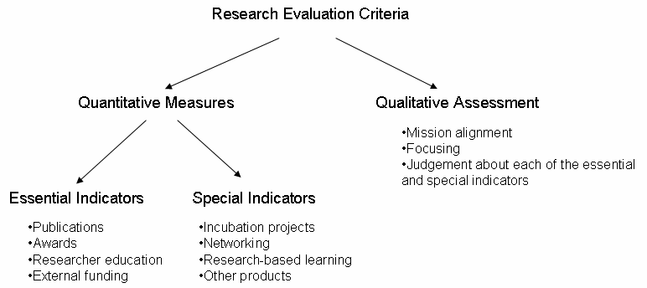
Research Evaluation criteria

Slide 4
Deeper dive
University based researchers are evaluated through,
Publications
Level of funding
Record of trainee supervision

Slide 5
Method Proposed
A system that analyze and visualize the grant dataset that is used for research to gain insights around the science and technology research in canada.

Slide 6
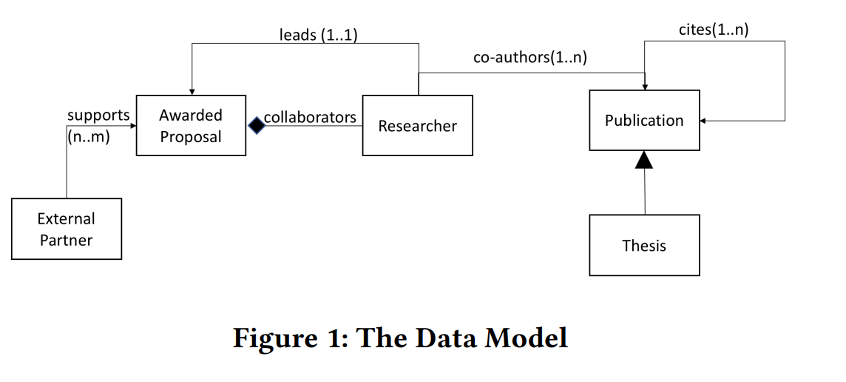
Data Model

Slide 7
Other Existing Methods
Research evaluation method based on social network analysis.
Citesearch and ArnetMiner are the most notable tools.
http://citeseerx.ist.psu.edu/viewdoc/summary?doi=10.1.1.456.7331

Slide 8
The Data Collection
In this paper they have used the NSERC open dataset.
https://open.canada.ca/data/en/dataset/c1b0f627-8c29-427c-ab73-33968ad9176e
Duration: 1991 to 2018
Word count: 458,971 words.
Awards were adjudicated by 270 committees and researchers.

Slide 9
Profile Construction
Researcher profiles are constructed based on,
Researcher name
Grants allocated
Academic affiliations

Slide 10
Problems of profile construction
If there are two researchers with the same name then, they can be distinguished by,
Classifying whether they belong to the same institution and department.
If they belong to the same institution, but different department.
In other cases they are classified as distinct.

Slide 11

What can the data tell us?
The main purpose of the system in this paper is to examine questions around the scholarly work.
Analyzing the research profiles
Analyzing themes
Exploring the funding trends
Analyzing the collaborative relations

Slide 12
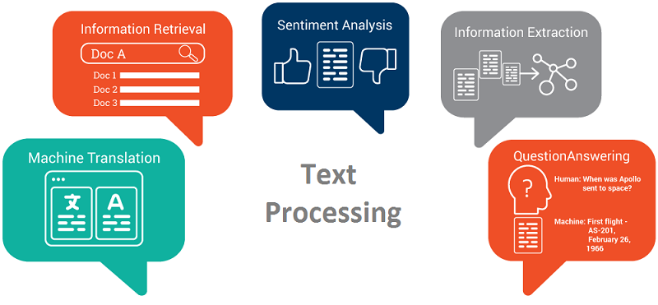
Textual similarity analysis
Similarity metrics like TF-IDF is used to identify the important n-grams.
Next, the Characteristic terms of each proposal is identified.
Similarity between two proposals are computed based on cosine, Euclidean and Jaccard metrics.
The same methods are used for processing the researcher profiles

Slide 13
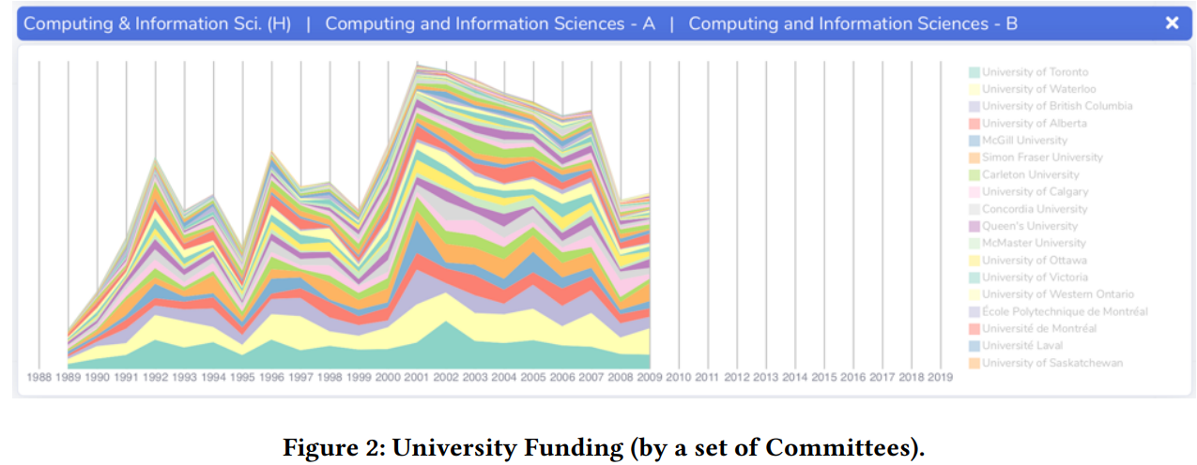
University performance

Slide 14
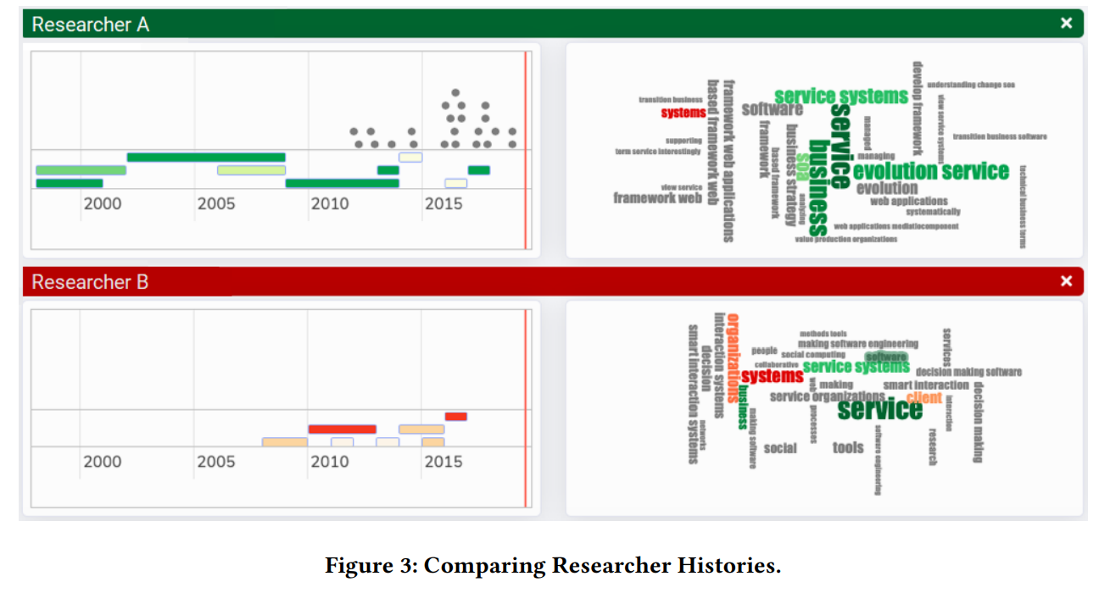
Researchers Histories
The researcher’s proposals and papers published over time, as colored bars and grey points.

Slide 15
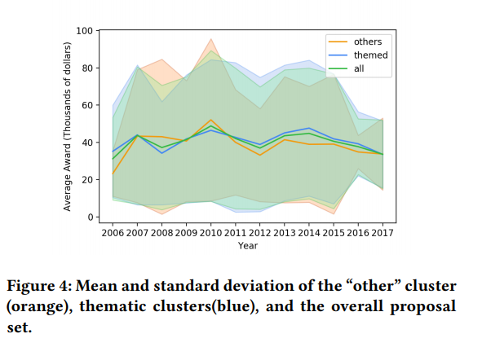
Research themes
The theme of researches evolved over time is processed by the following methods,
The data subset processing
Preprocessing the proposal
Representation of data
Creating a evolution graph

Slide 16
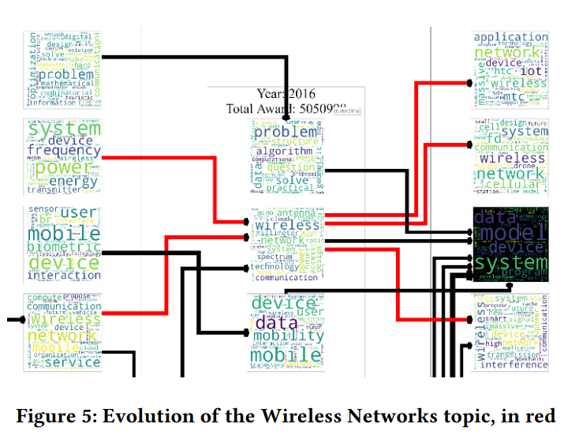
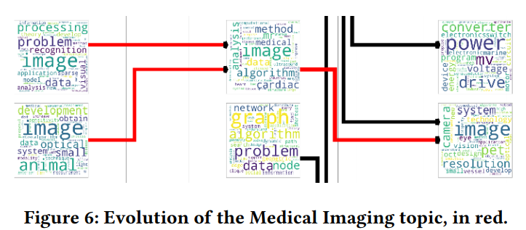
Evolution of Networks and medical Imaging

Slide 17
Conclusion
No user study has been performed on this analysis.
Analyzing the open data published by NSERC to gain insights on the Canadian Science and-Technology Research Landscape.
Researchers may use such analyses to identify thematically related pockets of research, in order to better situate their work in the context of their field and the outputs of their peers

Slide 18
Thank you !!!

